Slide 1
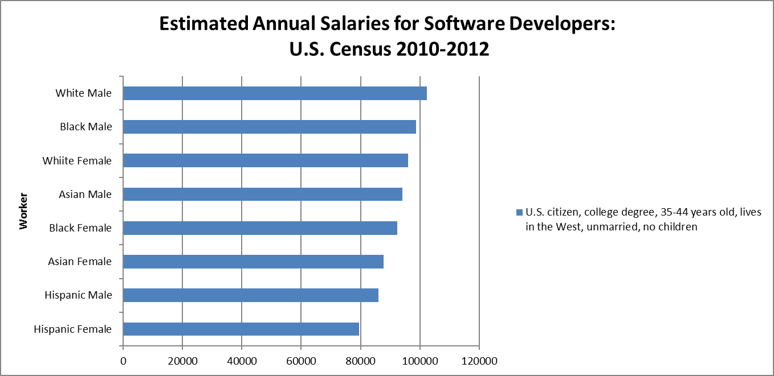
Guynn, Jessica (2014, Oct. 9). High-tech pay gap: Minorities earn less in skilled jobs. USA Today.

